Slide 1
Odd and Even Functions with their Fourier Series, Half range Expansion of Fourier Series
(11637) Ammar UD Din

Slide 2
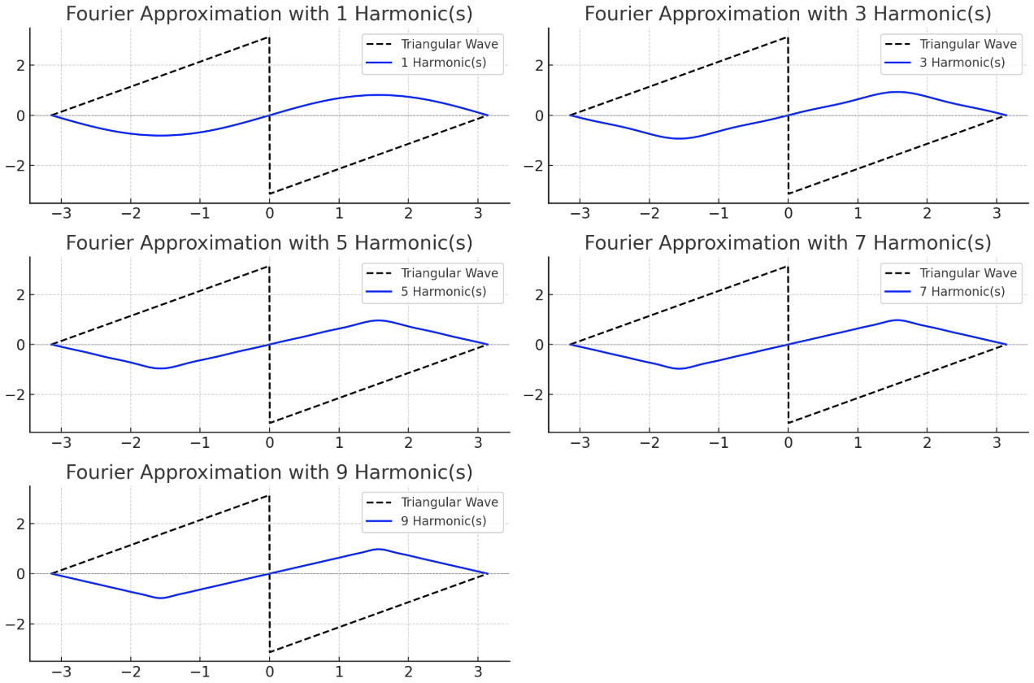
4) Examples (1): ODD FUNCTION WITH FOURIER SERIES
Triangular / Sawtooth Wave
These waves are commonly used in:
Electronics
Audio synthesis
Signal processing

Slide 3
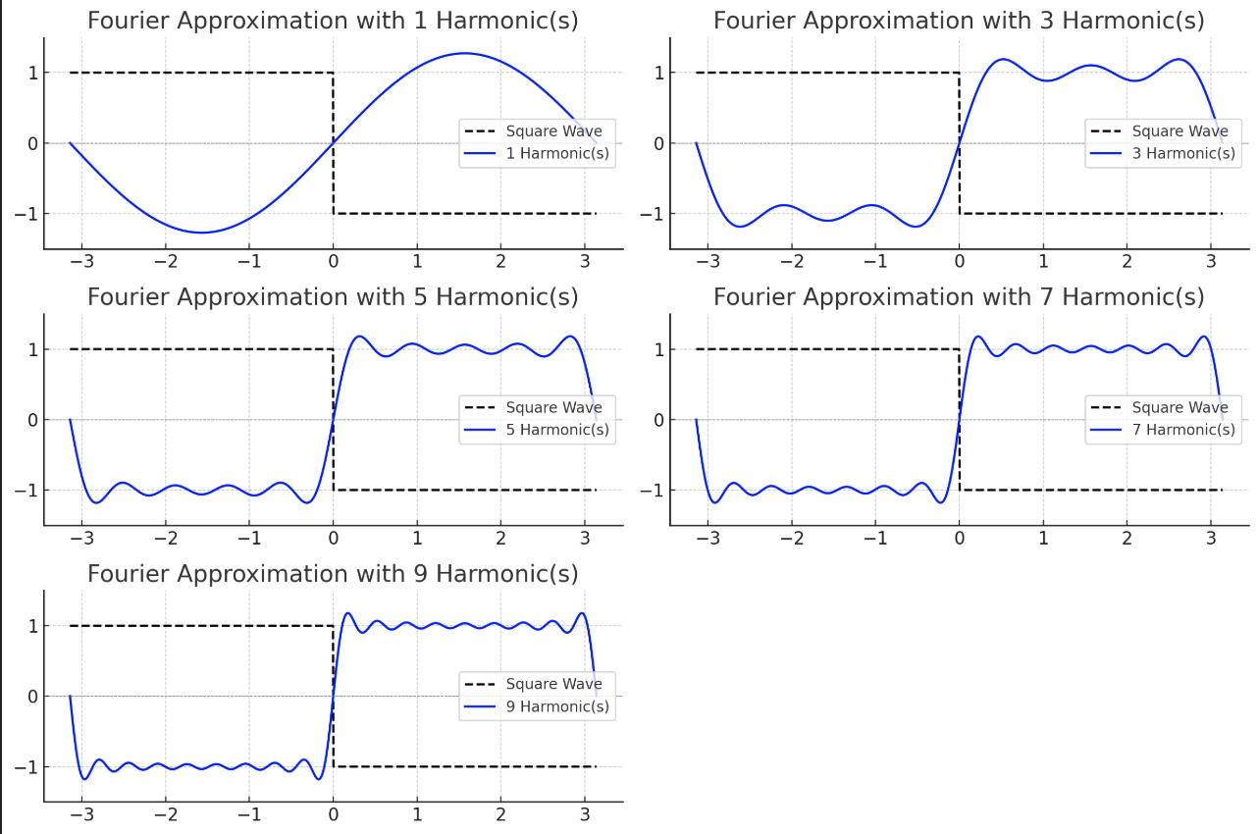
4) Examples (2): ODD FUNCTION WITH FOURIER SERIES
Square wave
These types of functions appear in:
Digital Electronics
Clock Signals
Music Synthesis
Control Systems

Slide 4
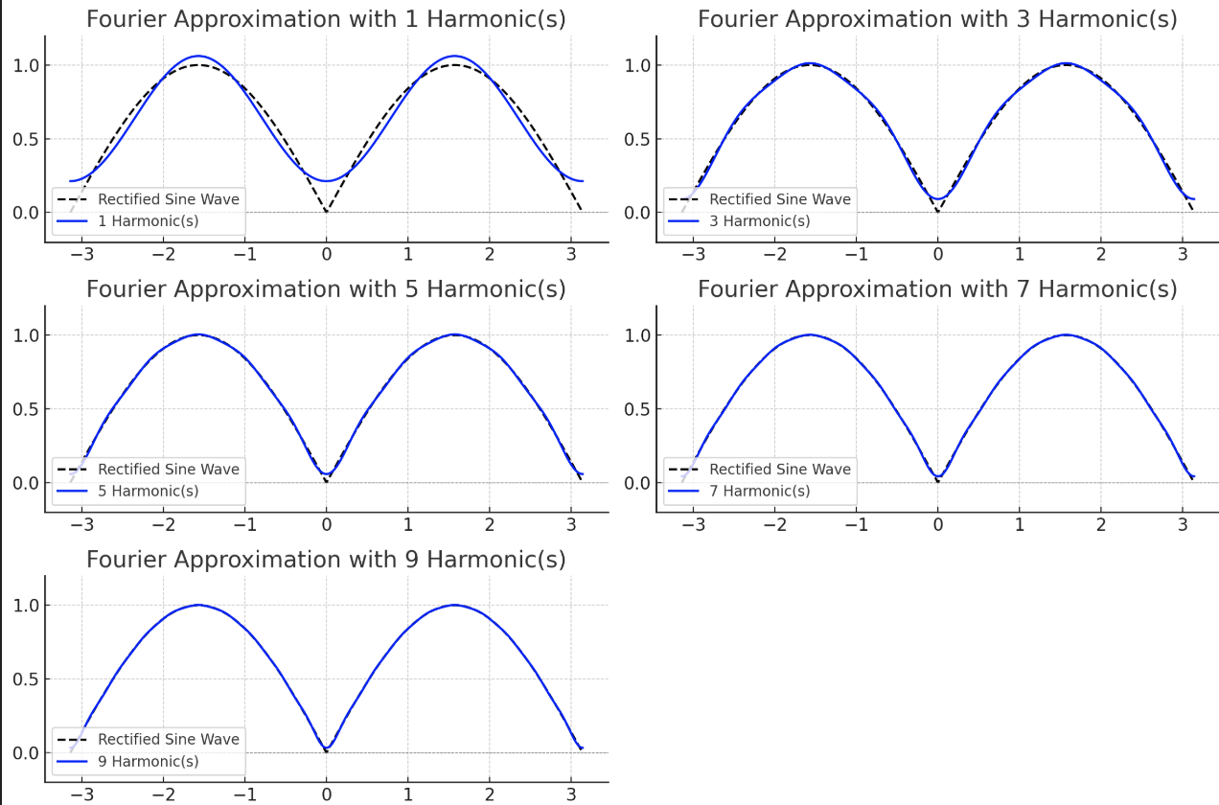
4) Examples (1): EVEN FUNCTION WITH FOURIER SERIES
Rectified sine wave
These types of functions appear in:
AC power systems
Signal Processing

Slide 5
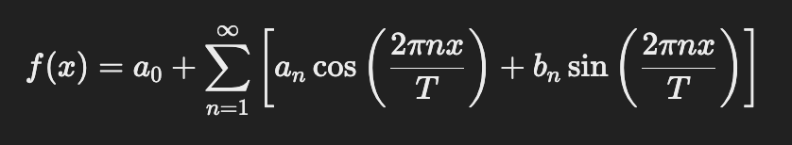
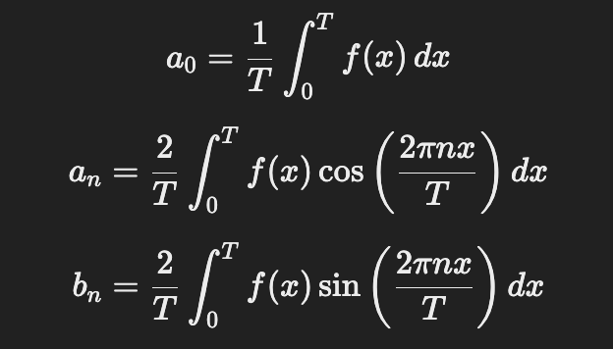
Numerical Example:

Slide 6

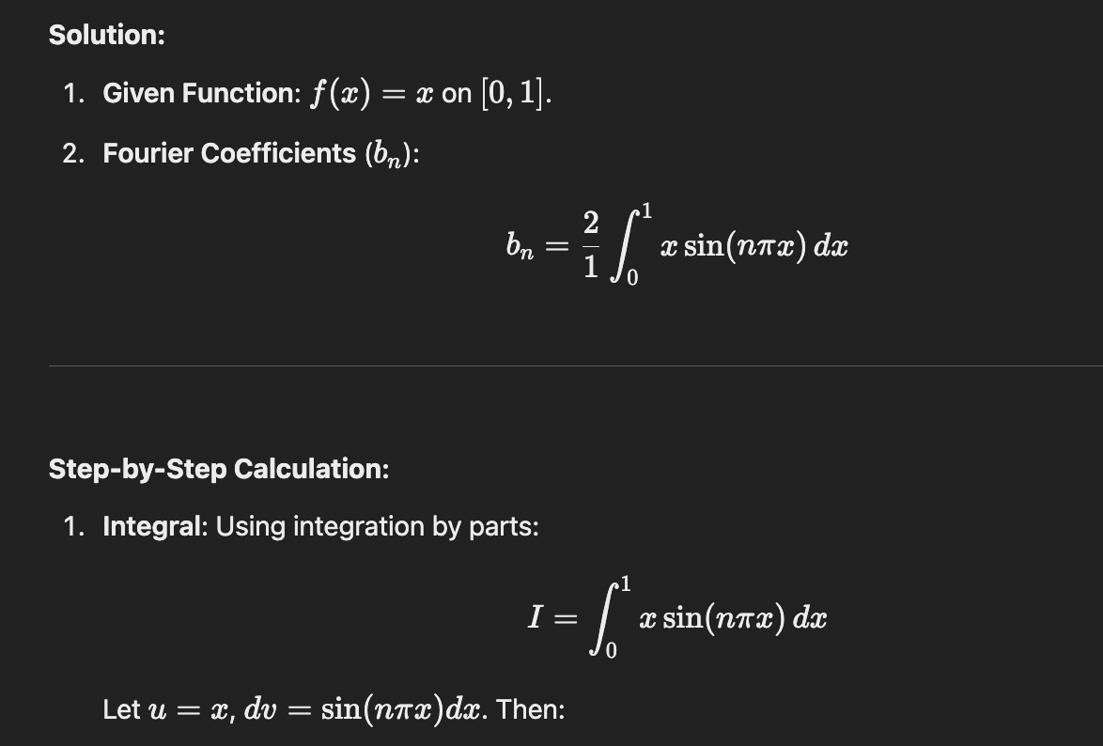

Slide 7
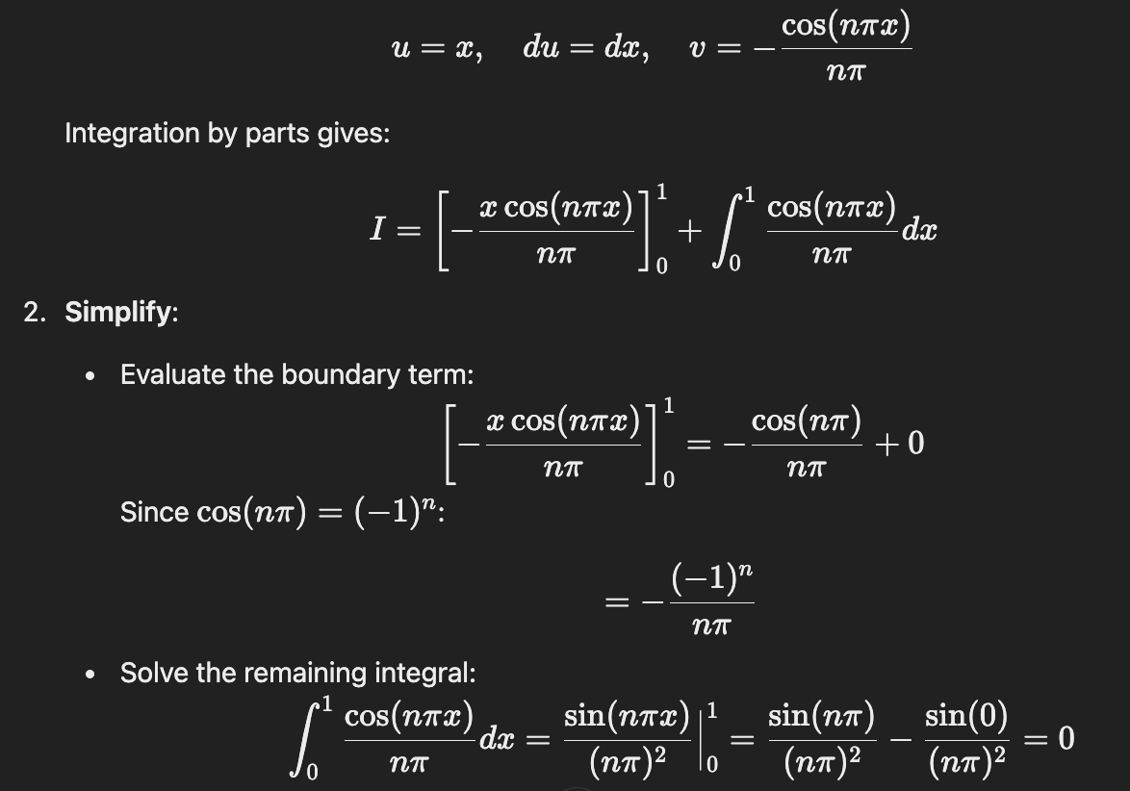

Slide 8
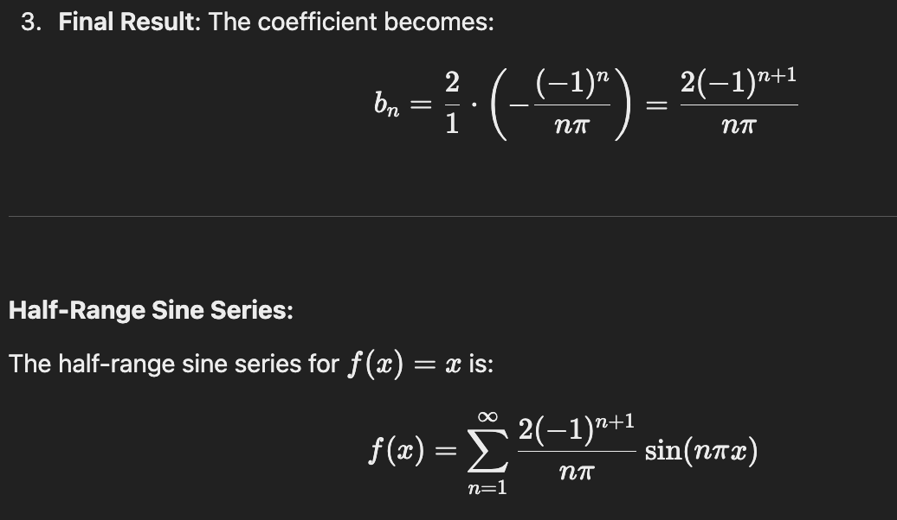

Slide 9
Key Points
Even functions are symmetric about the y-axis
Odd functions are symmetric about the origin
Fourier series is a mathematical tool used to represent a periodic function as a sum of sine and cosine functions
Complex periodic signals into simpler sinusoidal components.
Simplifying computations through symmetry.
Enable efficient and compact representation of functions.
Separating signals into meaningful components for analysis and applications.

